Slide 1
Bagging, Random Forests, and Boosting
September 2019
A forest doesn't weep over one tree.
- Aleksandr Solzhenitsyn

Slide 2
Reminder/revision: Cross Validation

Slide 3
Live Coding Example k-fold cv
Revising:
k-fold cross validation
k disjoint partitions (no overlap), all observation participate
Repeated random sub-sampling validation
AKA Monte-Carlo cross-validation), validation can be any size, some observations may be skipped
In k-fold CV, how many times would observation i appear in the train set?
/class code/03-cv_example.R

Slide 4
Reminder: Classification and Regression Trees

Slide 5
Building Trees
Classification and Regression Trees is an algorithm used to divide the space into sub-regions. In each region the prediction is given according to the observations which “reside” in the region.
This makes trees a very flexible model.
Trees can be used for either regression or classification.
Caution, flexibility = very high bias = can be easily abused into over-fitting.

Slide 6









Example: How a Tree Classifies
Plane ($p=2$, two classes)
Example tree
Train set error:
Err 46%
Root
$$x_{2}$$
7
6
$$x_{2}≤t_{1}$$
yes
no
$$t_{1}$$
Err 23%
6
2
1
4
$$x_{1}≤t_{2}$$
$$x_{1}≤t_{3}$$
Err 8%
y
n
y
n
Leaf
Leaf
Leaf
Leaf
0
2
6
0
0
4
1
0
$$t_{2}$$
$$t_{3}$$
$$x_{1}$$
Err 0%

Slide 7
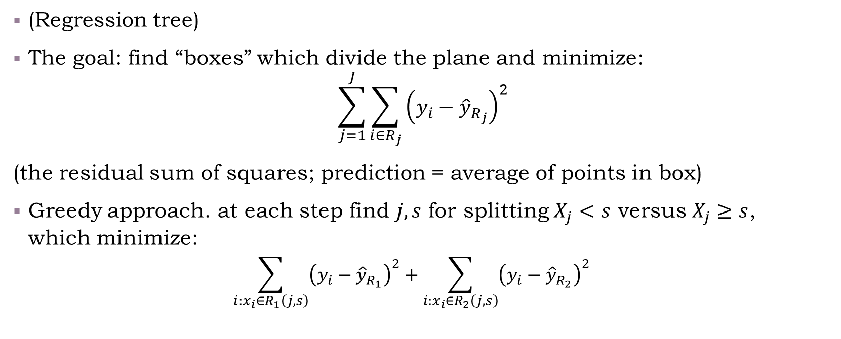
How a Tree is Grown?
(Regression tree)
The goal: find “boxes” which divide the plane and minimize:
$$\sum_{j=1}^{J}{\sum_{i∈R_{j}}{{\left(y_{i}−{\hat{y}}_{R_{j}}\right)}^{2}}}$$
(the residual sum of squares; prediction = average of points in box)
Greedy approach. at each step find $j,s$ for splitting $X_{j}<s$ versus $X_{j}≥s$, which minimize:
$$\sum_{i:x_{i}∈R_{1}\left(j,s\right)}{{\left(y_{i}−{\hat{y}}_{R_{1}}\right)}^{2}}+\sum_{i:x_{i}∈R_{2}\left(j,s\right)}{{\left(y_{i}−{\hat{y}}_{R_{2}}\right)}^{2}}$$
Recursive binary splitting

Slide 8
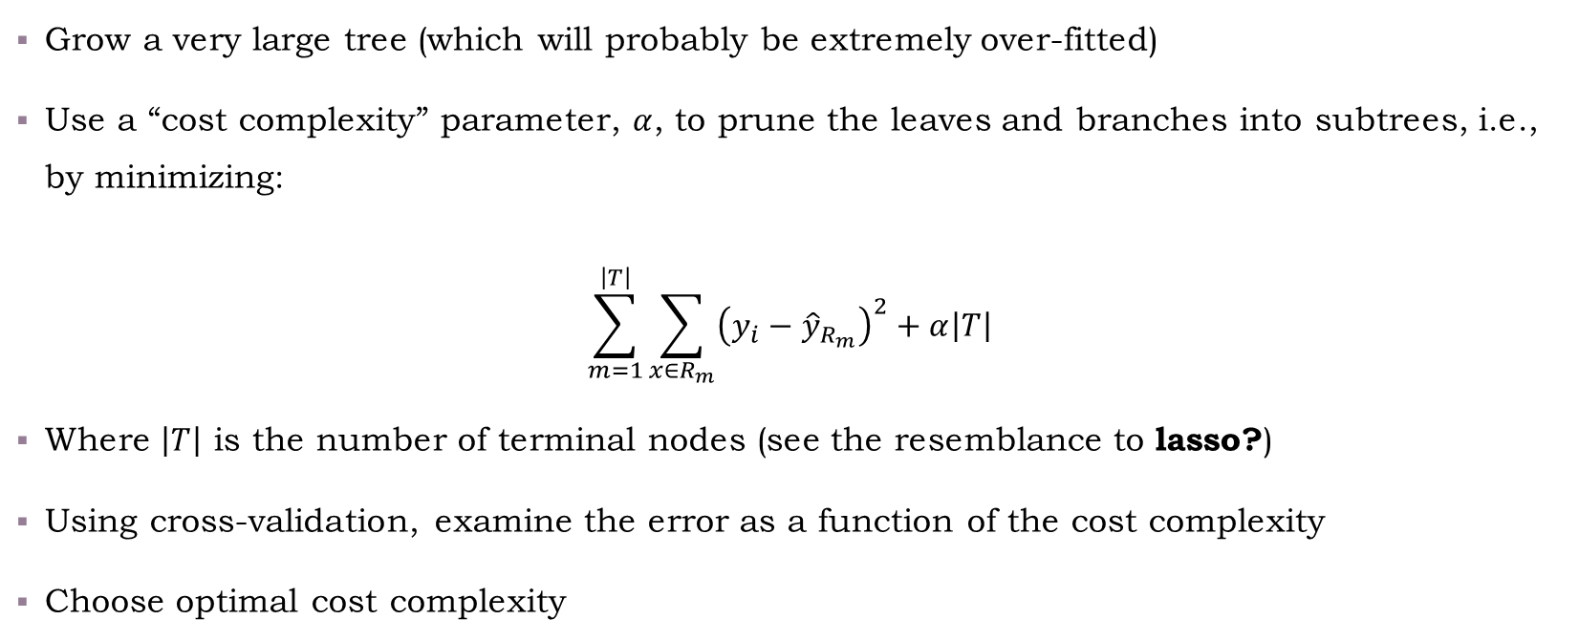
Tree Pruning
Grow a very large tree (which will probably be extremely over-fitted)
Use a “cost complexity” parameter, $α$, to prune the leaves and branches into subtrees, i.e., by minimizing:
$$\sum_{m=1}^{\left|T\right|}{\sum_{x∈R_{m}}{{\left(y_{i}−{\hat{y}}_{R_{m}}\right)}^{2}+α\left|T\right|}}$$
Where $\left|T\right|$ is the number of terminal nodes (see the resemblance to lasso?)
Using cross-validation, examine the error as a function of the cost complexity
Choose optimal cost complexity

Slide 9
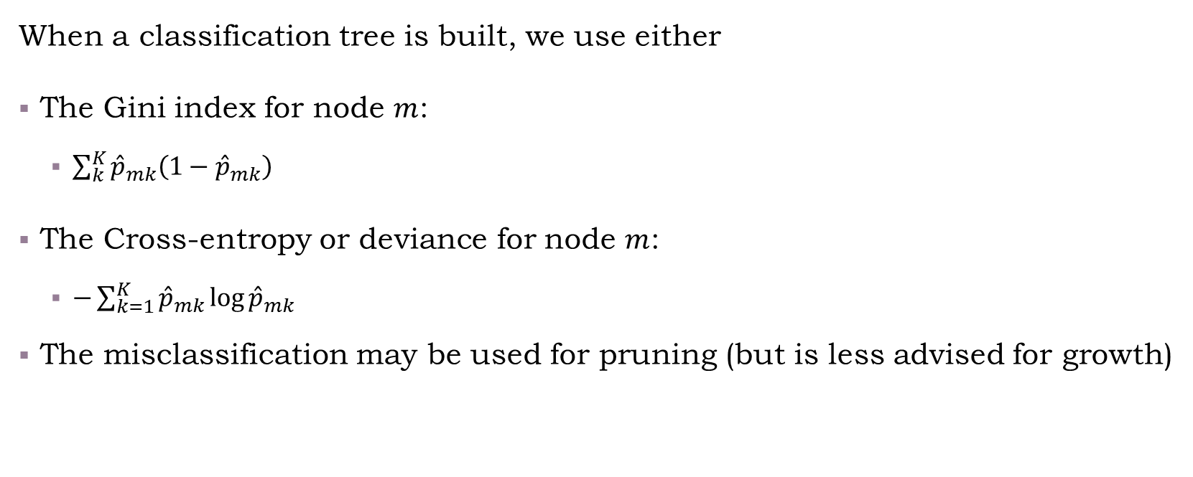
Classification Trees
When a classification tree is built, we use either
The Gini index for node $m$:
$\sum_{k}^{K}{{\hat{p}}_{mk}\left(1−{\hat{p}}_{mk}\right)}$
The Cross-entropy or deviance for node $m$:
$−\sum_{k=1}^{K}{{\hat{p}}_{mk}\log{{\hat{p}}_{mk}}}$
The misclassification may be used for pruning (but is less advised for growth)
Notes:
For details about measures and why misclassification is not that advised, see ESLII pages 309-310.

Slide 10
Contents for today
Unsupervised learning
Supervised learning
Methods
Models
Model evaluation
Linear methods
Classification
Regression
Boosting
Bagging
randomForest
Trees

Slide 11
Bagging (“bootstrap aggregation”)

Slide 12
What is Bootstrap?

Slide 13
How is Bagging Related to Bootstrap?

Slide 14
Bagging Example

Slide 15
Random Forests

Slide 16
Random Forest Algorithm

Slide 17
Random Forest Example

Slide 18
Boosting

Slide 19
Boosting Algorithm

Slide 20
Boosting Example

Slide 21
Contents for today
Unsupervised learning
Supervised learning
Methods
Models
Model evaluation
Linear methods
Classification
Regression
Boosting
Bagging
randomForest
Trees

Slide 22
Bonus: Optimization

